Slide 1
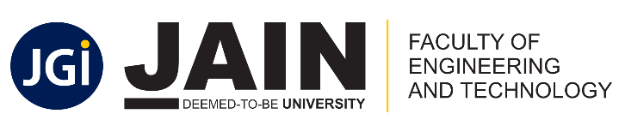
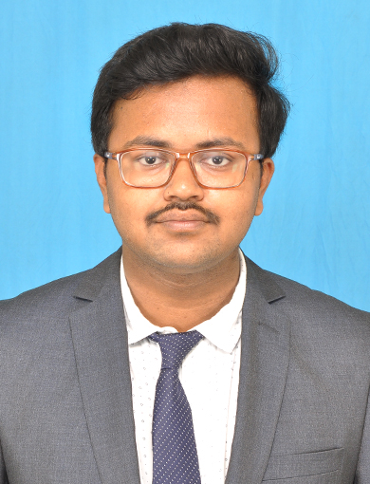
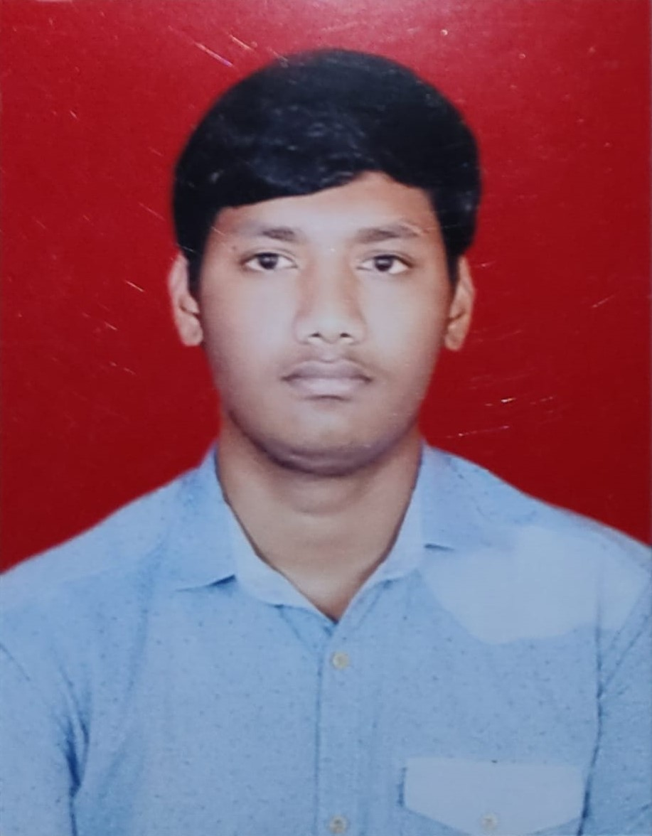

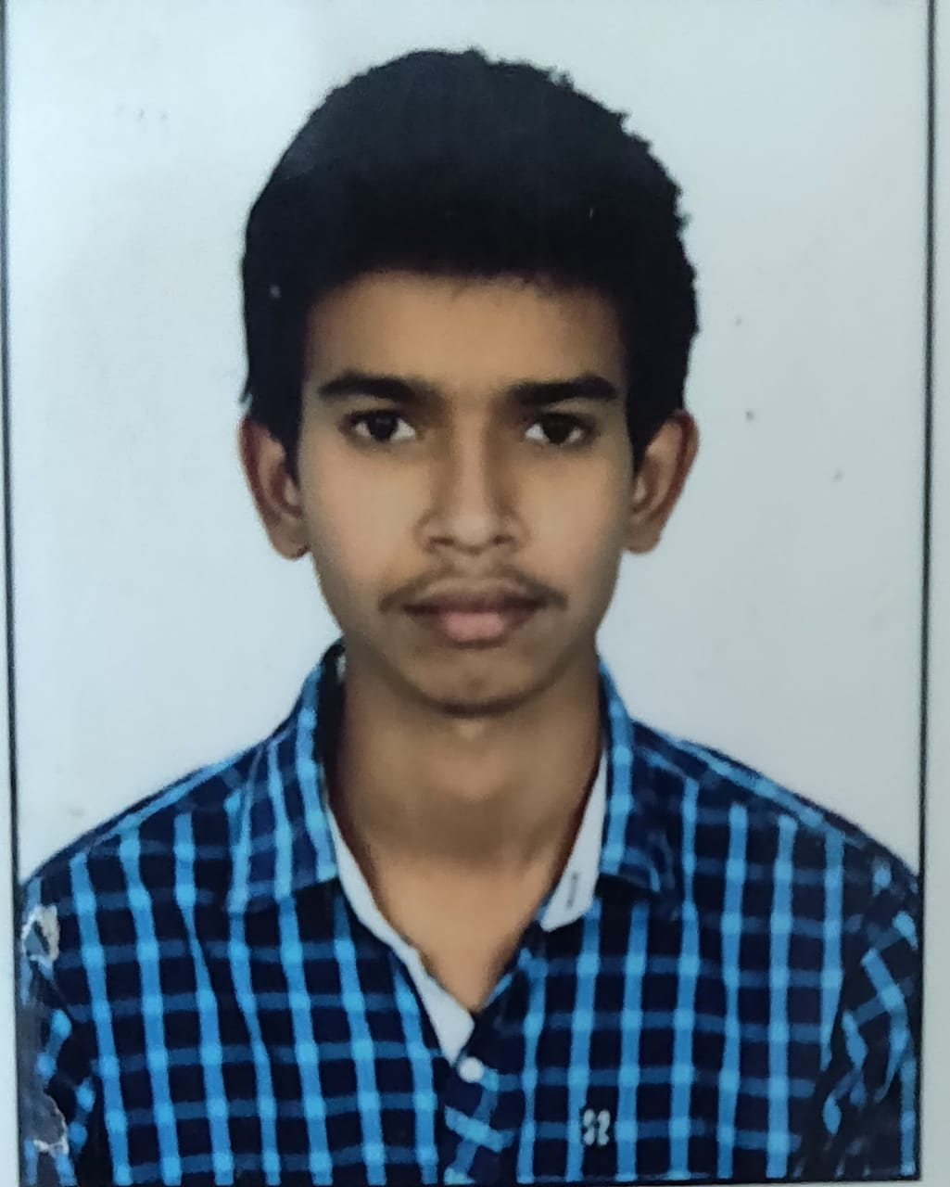
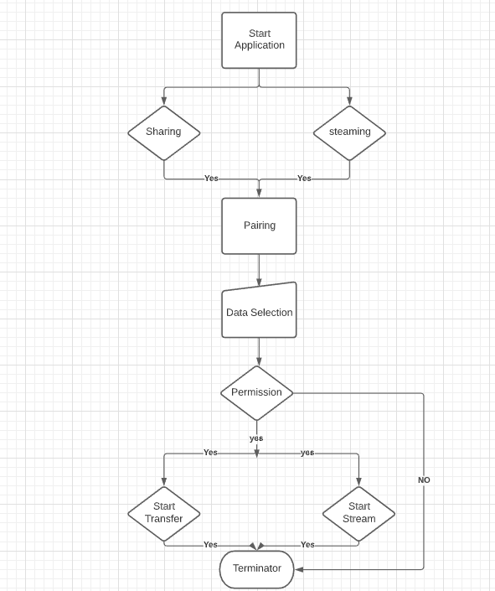
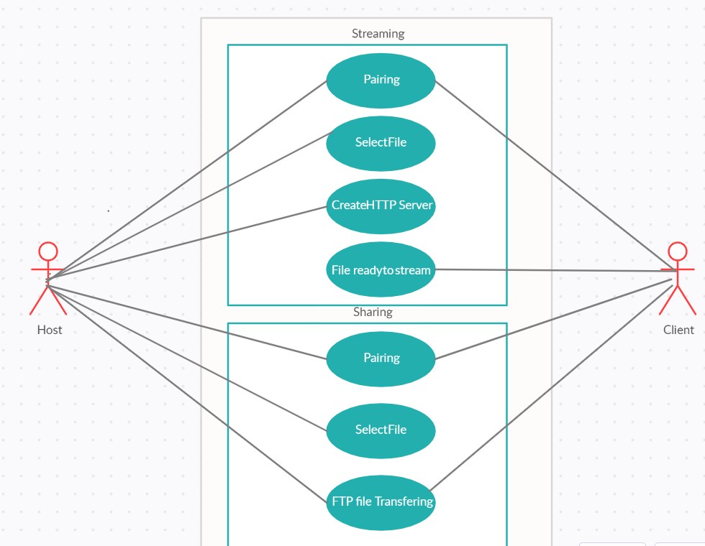
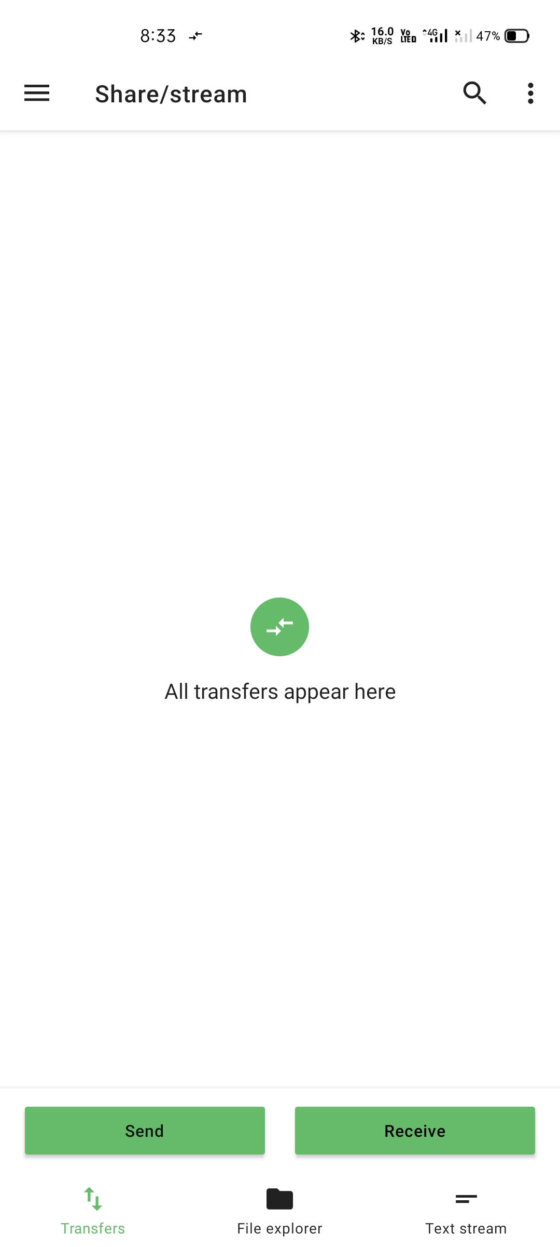
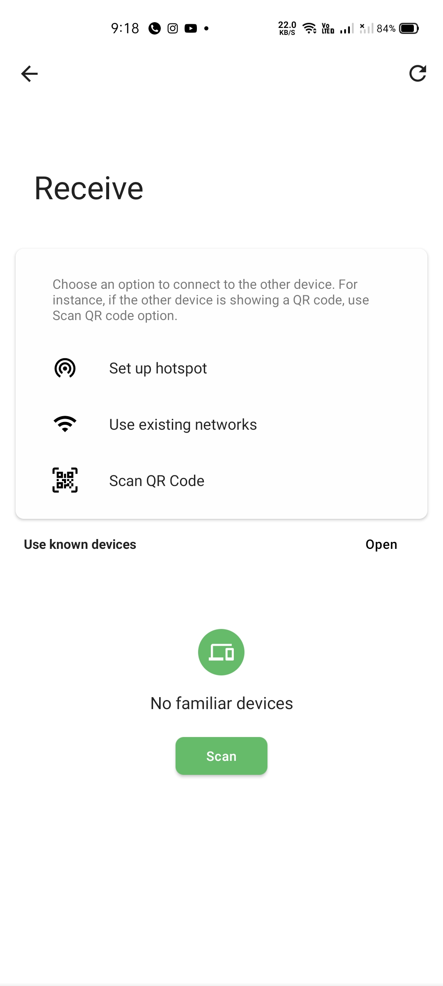
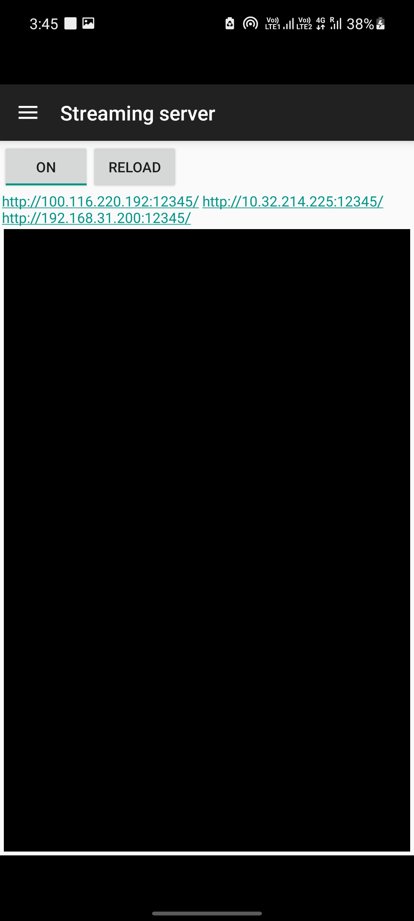
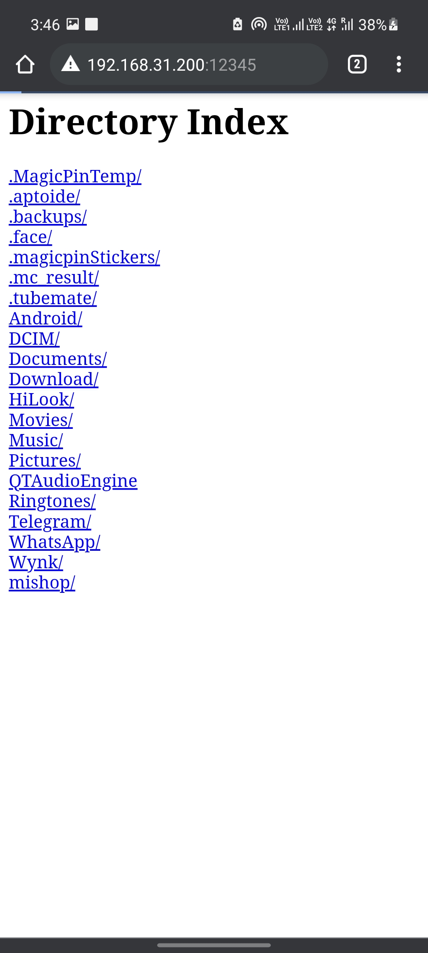
Fold or cut poster here
Fold or cut poster here
Batch Number:2
Department of Information Science and Engineering
Final Year Project Poster Presentation (UG - B.Tech)
Multimedia streaming and File sharing
Introduction
System Architecture
Methodology used
Abstract:
As we know sharing and streaming of data has been a major concern these days and internet is required to share the data between parties. Streaming and sharing larger data over the internet could be a costly process. Instead, through our application we can minimize this issue to some extent by transferring the data/files between two parties which are connected locally (through the application) and without help of internet.
Streaming media is multimedia that is constantly received by and presented to an end-user while being delivered by a provider. The stream refers to the process of delivering or obtaining media in this manner. Streaming refers to the delivery method of the medium, rather than the medium itself. Distinguishing delivery method from the media distributed applies specifically to telecommunications networks, as most of the delivery systems are either inherently streaming (e.G. Radio, television, streaming apps) or inherently non-streaming (e.G. Books, video cassettes, audio cds).
File sharing is the practice of distributing or providing access to digital media, such as computer programs, multimedia (audio, images and video), documents or electronic books. File sharing may be achieved in a number of ways. Common methods of storage, transmission and dispersion include manual sharing utilizing removable media, centralized servers on computer networks, world wide web-based hyperlinked documents, and the use of distributed peer-to peer networking.
Streaming
The streaming part of the application uses the low-latency streaming protocol over traditional streaming protocols which are emphasizes on quality of the content.
HTTP based streaming protocol called low-latency HLS is used in streaming process of the application
The mini HTTP server created in the host device and low-latency HLS protocol facilitates the delivery of the data between the devices.
Streaming can be achieved when the two Android devices and connected through a local network such as hotspot connection or a WIFI direct feature
File transferring
The sharing feature of the application uses peer-to-peer(p2p) file transfer protocol
I.E., FTP protocol ,and transfers the data between devices
Application uses the Wi-Fi-direct or hotspot or any local network to facilitate data transfer between the devices
Design and Implementation
Design and Implementation
File Sharing:
We developed an application which can share files when two devices are connected in a local network like Wi-Fi-hotspot or a Wi-Fi-direct. In order to share file we just need to start selecting files after selecting you need to connect to a device through local network and can send the files
Streaming:
We developed an application in which you can stream multimedia when connected in a local network. Basically we create a http server in the host device and client can access the files in host device by any browser. In order to access files both the devices should be connected to the same network.
Conclusion
Paper Publication Details
We have studied different methodologies for the multimedia streaming and sharing which helps the users to share data over and over again. Despite of having many applications to do so it is very costly and time taking. Our application will let the user to transfer the multimedia data over a local connection such as WIFI-direct seamlessly. The application does not require an internet connection.
We have published our paper on Multimedia streaming and file sharing in INFOCOMP Journal of Computer Science and waiting for the approval.
Results
References
Contact information
The application is able to stream and share the media seamlessly using local connections like Wi-Fi direct or hotspot.
The user will be allowed to share and stream any kind of media files, without any interruptions and will not be charged any data such as mobile data or Wi-Fi data.s
Design of a Media Stream Relay Engine on the Android OS
Huigwang Je, Dongwoo Kwon and Hongtaek Ju
Mobile Network Configuration for Large-scale Multimedia Delivery on a Single WLAN
Huigwang Je, Dongwoo Kwon, Hyeonwoo Kim, and Hongtaek Ju
P2P Networking: An Information-Sharing Alternative
Manoj Parameswaran, Anjana Susarla Andrew, B. Whinston
In-Kernel Relay for Scalable One-to-Many Streaming
Ying-Dar Lin, Chia-Yu Ku, Yuan-Cheng Lai, Chia-Fon Hung
A Transport Protocol for Supporting Multimedia Streaming in Mobile Ad Hoc Networks
Hayoung Yoon, JongWon Kim
Under the guidance of Assistant Prof: MATHIYALAGAN
Student Name V K Sakthi swarup Jonnavaran Maheshwar Reddy Gangireddy Hari Sainath Reddy Para Ashok | USN 1.17BTRIS044 2.17BTRIS019 3.17BTRIS018 4.17BTRIS024
Fold or cut poster here
Fold or cut poster here

